Slide 1

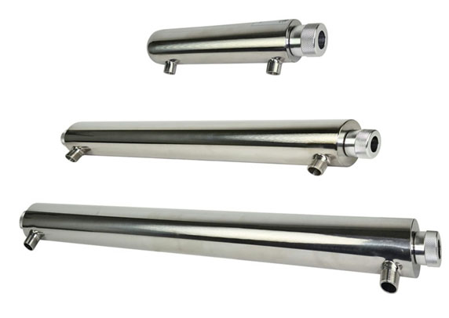
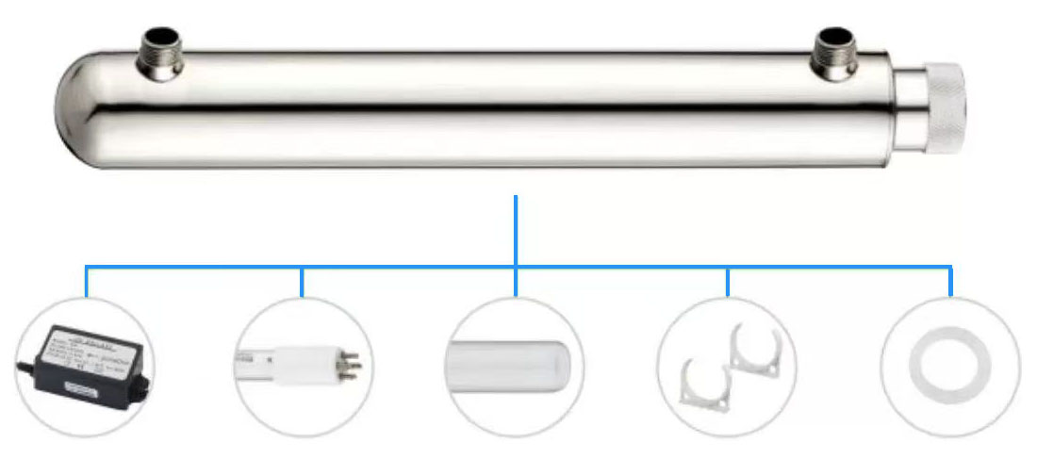
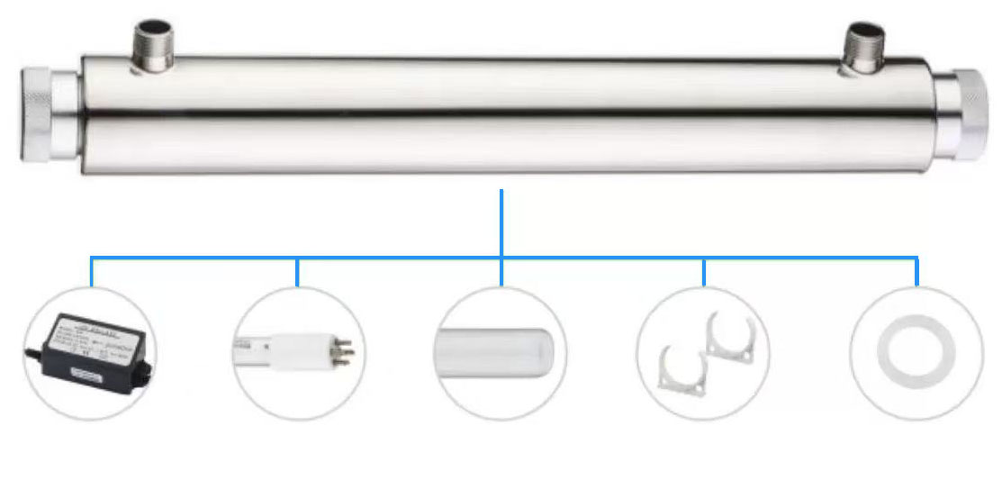
Ultraviolet (UV) sterilizer is a disinfection device that uses short wave ultraviolet light (UVC, wavelength 200-280nm) to destroy microbial DNA/RNA, causing it to lose its reproductive ability. It is widely used in water treatment, air purification, and surface sterilization.
UV Sterilizer
FEATURES
Reliable High-performance UV lamp, rigorously tested to provide consistent output over the entire lamp life
Controller will go into alarm if the lamp fails
UV chamber with great welding process which enables to pass 1.04MPa 100,000 times water hammer test
Perfect for a wide range of single-faucet, point-of-use or low flow point-of-entry water treatment solutions in homes,cottages, or OEM applications.
Model | Flow rate m³/hr | GPM | Reactor dimension | Interface Size | Lamp power
BSD-004 | 0.07 | 0.3 | 200 X 50.8mm | 1/4" | 4w
BSD-006 | 0.1 | 0.5 | 260 X 50.8mm | 1/4" | 6w
BSD-012 | 0.2 | 1 | 315 X 50.8mm | 1/4" | 12w
BSD-016 | 0.4 | 2 | 375 X 63.5mm | 1/2" | 16w
BSD-025 | 1.4 | 6 | 595 X 63.5mm | 1/2" | 25w
BSD-030 | 1.8 | 8 | 915 X 63.5mm | 3/4" | 30w
BSD-035 | 2.0 | 9 | 955 X 63.5mm | 3/4" | 35w
BSD-040 | 2.3 | 10 | 890 X 63.5mm | 3/4" | 40w
BSD-055 | 2.7 | 12 | 955 X 63.5mm | 3/4" | 55w
BSD-080 | 3 | 12 | 910 X 63.5mm | 3/4" | 80w

