Slide 1

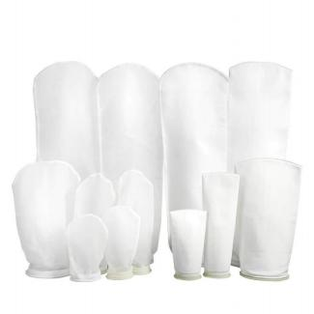
Liquid Filter Bag
Liquid filter bag is a common industrial filter element, mainly used to remove solid particles, suspended solids or other impurities in liquids, widely used in industries such as chemical, food, pharmaceutical, water treatment, petroleum, etc.Liquid bag filters in a large range of micron ratings as well as in the standard #1, #2,#3 and #4 sizes to fit your filter bag requirements. Choose from nylon monofilament mesh，PP (polypropylene) and PET(Polyester) media replacement filters.
Liquid Filter Bag Size And Liquid Flow Rate
Size | Diameter |  | Length |  | Filtration Surface Area （m2/h） | Flow Rate
 | mm | inch | mm | inch |  | m2
#1 (7" x 17") Filter Bag | 180 | 7 | 430 | 17 | 0.25 | 20
#2 (7" x 32") Filter Bag | 180 | 7 | 810 | 32 | 0.5 | 40
#3 (4" x 9") Filter Bag | 102 | 4 | 230 | 9 | 0.09 | 6
#4 (4" x 15") Filter Bag | 102 | 4 | 380 | 15 | 0.16 | 12
Liquid filter bag specifications
MATERIALS
Filter Media | nylon,PP(polypropylene) , PET(Polyester)
Ring | Plastic, SS 304
Sealing | Welded, Welded and Sewn
RETENTION RATINGS
Polypropylene | 1, 5, 10, 25, 50,100,200,300µm
Polyester | 1, 5, 10, 25, 50,100,200,300µm
Organic
Solvents
Microorg
anisms
Filter bag material compatibility and temperature limits
Fabric | Animal,Vegetable and Petro Oils | Alkalis | Organic Acids | Oxidizing Agents | Mineral Acids | Temperature Limitations (maximum degrees)
Polypropylene | Excellent | Excellent | Excellent | Good | Good | 93 °C (200 °F)
Polyester | Excellent | Good | Good | Good | Good | 149 °C (300 °F)
Nylon | Excellent | Good | Fair | Poor | Poor | 163 °C (325 °F)

